Slide 1
Simple Planet Wars
A fast real-time strategy game playable by GVGAI Agents

Slide 2
Aims
Develop a game with interesting strategic elements
Very fast to simulate
Must be > 1m game ticks per second
Prefer > 10m ticks per second
Copy function must be fast also (> 1m copies per second)
Copying is not as speed-critical as the next state function, since it is called less frequently
Simple action space, directly playable by GVGAI agents

Slide 3
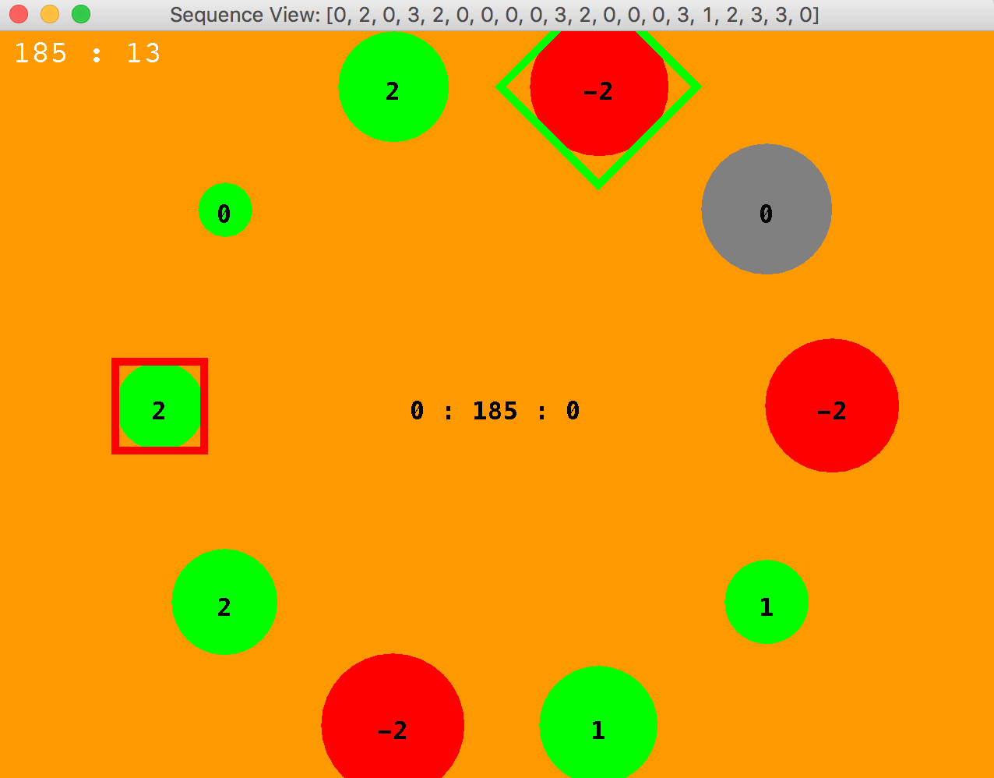
Screen Shot
This shows a game replay
The title shows the action sequence made by an evolving action sequence agent
Currently being replayed
Red square shows the focus of the red player
Green diamond is the focus of the green player
What is focus? Next slide…

Slide 4
Current version
Each player has a ‘current planet’ that their attention is focused on
5 actions
Do nothing
Move left, move right: this moves the current focus (actually planets are arranged in a circle, so these currently mean move clockwise or anti-clockwise)
Store: transfer ships from current planet to s “ship buffer”; currently, 50% of ships on current planet are moved each time. This could be a tunable parameter
Deploy: transfers (currently all of) the ships in the buffer to the current planet. This will attack a planet if the current one is owned by the opponent, or help defend if the planet is currently owned by the player

Slide 5
Current status and next Steps
The game has been implemented and tested
An evolutionary agent has been developed to play it, and tested against a ‘do nothing’ player
Next steps fall in to the following categories
Testing some sample agents
Optimising the parameters of a sample agent
Testing effects of varying heuristic / reward structure
Improving the Game – e.g. Ship Collisions
Optimising the parameters of the game
More about these now

Slide 6
Sample Agents to Test
OLMCTS
EvoAgent (a rolling horizon agent, where the evolutionary algorithm can be plugged in, independently from the other details, such as shift buffer, discount factor, sequence length)
Random Agent
Minimax Agent
Note:
OLMCTS and EvoAgent can make use of different opponent modules
Random just plays uniform randomly and needs no opponent model
Minimax can work via assumed sequential moves, or via an AxA choice set at each node

Slide 7
Optimising the parameters of the Sample Agents
EvoAgent Parameters:
Sequence length
Discount factor
Evolutionary Algorithm
The evolutionary algorithm parameters will depend on the algorithm
E.g. RMHC: mutation rate
SlidingCompactMeanEDA: window length, K
SimpleGA (pop size, mutation rate, crossover rate, selection pressure)
OLMCTS
Discount rate
Exploration constant K
Rollout length
Recommendation Policy

Slide 8
Victory conditions
The current status is that only the Game Score matters, and this is simply the sum of all the ships of player A minus the sum of all ships of player B
Player A is the maximising; player B minimising
Game finishes after a fixed number of steps
Alternatives could be:
fix a number of ships difference to attain, and stop when reached
Game over when a single player occupies all the planets

Slide 9
Heuristics
Currently only the Game Score is used by the search algorithms
Would be interesting to experiment with adding some learned and / or hand-tuned heuristics
A good hand design one would be to consider the growth rate difference
The sum of all growth rates for planets owned by player A minus those owned by player B

Slide 10
Macro Actions
In this context macro actions would be to plan to invade or defend a planet, then plan in terms of which low-level actions to execute in order to do that

Slide 11
Evolving / Learning a Rollout Controller
This would be really interesting!
The inputs could simply be the current game state
And the action each time would be a function of that
Can think in terms of a harvest / deploy cycle

Slide 12
Cosmetic Improvements to the Game
Add sound
Display visual stack of ships
Background of twinkling stars

Slide 13
Improving Game Play
Have a size limit on the ship buffer
Lose ships that overflow
Or lose entire buffer if it overflows
Or lose game if it overflows
Add transfer delays
Could have a single line between the buffer of each player and each planet - in order to keep computational cost scaling linearly with the number of planets
The line is then either empty, or occupied
If occupied then a single number records the position of the fleet

Slide 14
Build Phase Choices (currently the player is not involved in the build phase)
Select locations of planets
Choose control features such as the buffer transfer amount

Slide 15
Optimising Game Parameters: this set will expand with more complex game variants
Growth rate variation (what random growth rates are given to the planets)
Neutral planets that are still occupied – distribution of number of ships
Buffer size (and effects of overflow)
Fleet transfer speed
Moving buffer – speed at which it moves
Note: the moving buffer idea is an added twist (no pun intended)

Slide 16
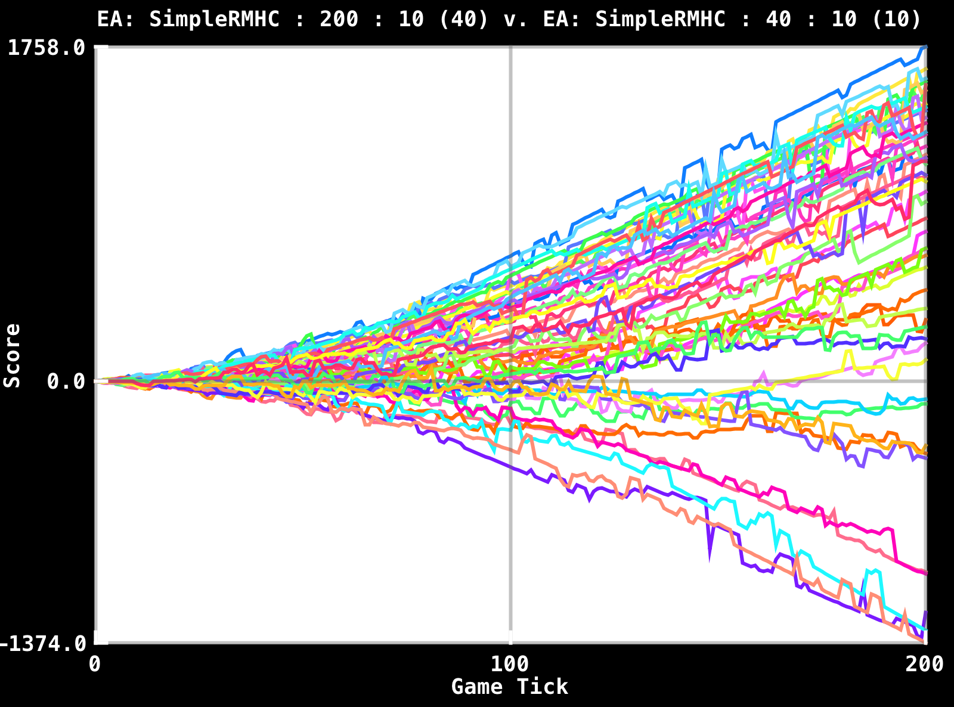
Observing Game Drama This shows how the score changes hands
Most lead changes (fluctuations around zero) occur in the early stages of the game
By tick 100 most but not all games have been decided
This is a based on EvoAgents, each using SimpleRMHC as the algorithm

